Slide 1
Getting a radio
licence with

Slide 2
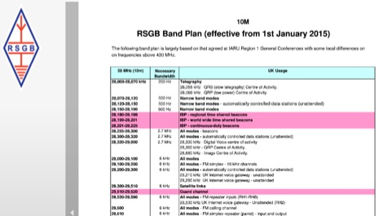
Why do we have licencing?
Cost
Accountability
Ensuring user competency
Setting a standard of operation

Slide 3
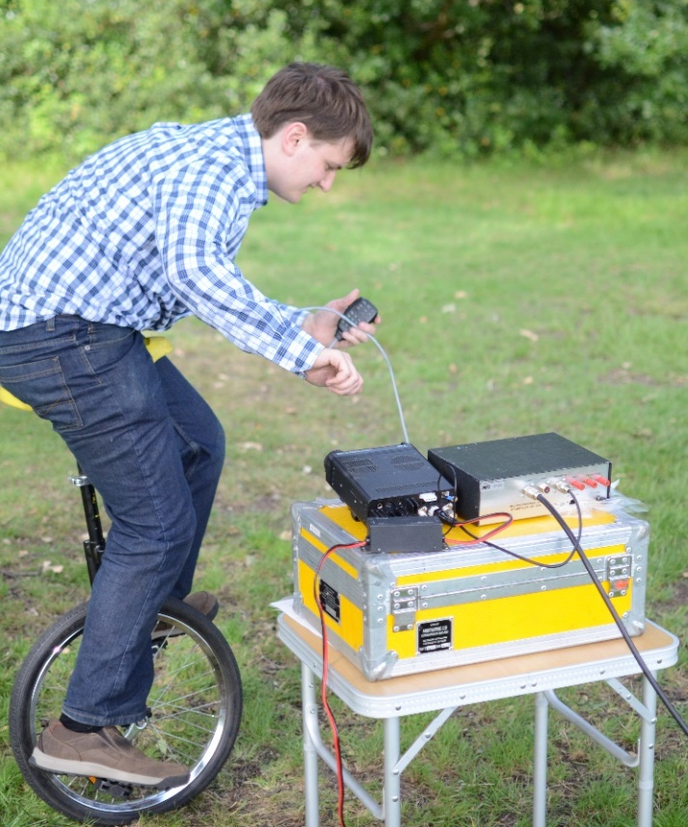
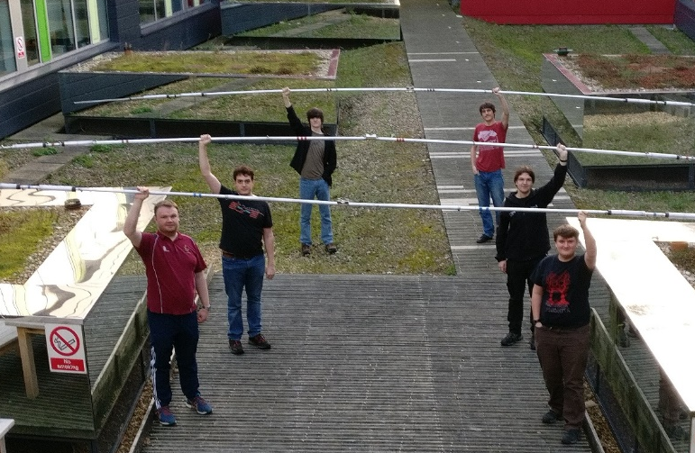
Why get a licence?
Transmit radio signals
Contesting
Friendly banter
Useful in emergencies!
Build your own kit – a good way to learn how it all works
Get involved in experimental radio systems
Digital voice and TV…

Slide 4
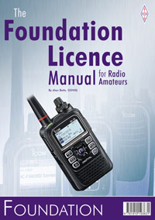
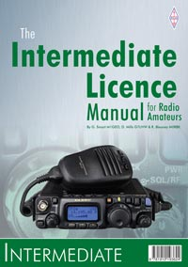
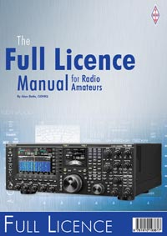
Licencing levels
Foundation
All common LF, HF, VHF, UHF bands + 10Ghz band
Limited power (10W max)
Intermediate
1 - 248Ghz bands
More power (50W max)
Build your own kit
Advanced / Full
All the bands
All the power (400W)
Operate abroad

Slide 5
How to get a licence
Practical assessment (foundation + intermediate only)
Intermediate practical tasks abolished (as of Aug 2020)
Foundation practical tasks are no-longer assessed (as of Oct 2021).
RSGB have provided instructional videos for the foundation tasks.
The Society recommends completing the practical task in person regardless and will offer this.
Multiple-choice test (all levels)
Exams can be run on campus, usually in a CLS room. But will take time to coordinate and plan.
Alternatively: Exams can now done online with TestReach software
Requires either Mac OS or Windows and a webcam.

Slide 6
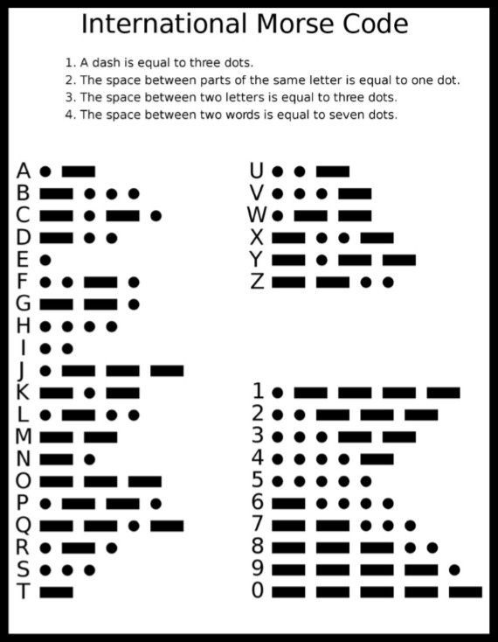
Foundation practical (as was…)
Radio operation (HF and VHF)
Practice how to talk to someone
Setting up a radio and dipole antenna
Morse appreciation
Show how an LED works

Slide 7
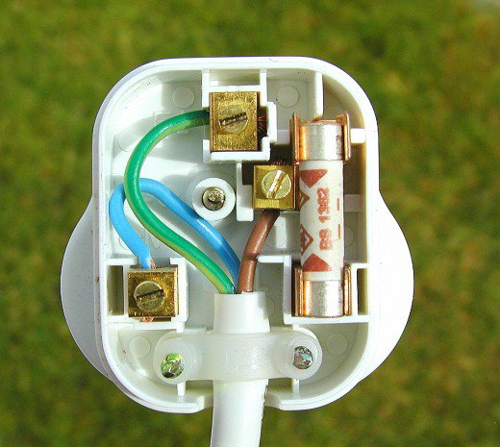
Intermediate practical (as was…)
Build a ham radio related project
Must involve soldering
Must involve a minimum number of active parts
Scorpia’s morse sounder kit is recommended
- But you can buy your own project if you want…
Solder a coaxial cable connector
Wire a 13A UK mains plug

Slide 8
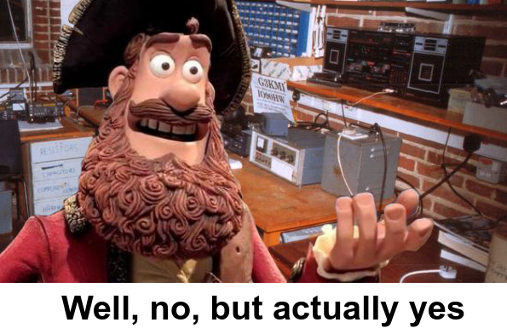
Who is eligible?
Current staff and students
Former staff and alumni
Third parties?

Slide 9
How much is it?
Access to SUWS resources requires membership
Pays for the upkeep of equipment
Members who complete at least one radio exam this academic year, and returns any borrowed resources will be reimbursed their membership fee.
Exam fees are set by the RSGB:
Foundation £27.50
Intermediate £32.50
Full/Advanced £37.50

Slide 10
Learning the course
Obtain an RSGB course book:
Also recommend the Exam Secrets book
https://www.rsgbshop.org/acatalog/Online_Catalogue_Training_19.html
Watch the practical assessment demos:
https://rsgb.org/main/clubs-training/for-students/foundation/foundation-practicals-video-guides/
Do a mock paper:
https://rsgb.org/main/clubs-training/training-resources/mock-exams/

Slide 11
Booking your exam
Read the online exam guidance
https://rsgb.org/main/clubs-training/exam-faq/
Book your exam online
https://rsgb.org/main/rsgb-examination-booking/
In-person exam
We may be able to resume doing this, but is subject to availability of invigilators.

Slide 12
Obtaining a licence
Once you have booked your exam, make sure you have the correct software!
The RSGB run exams online
Once you pass the exam, you’ll get a letter in the post from OfCom
RSGB do the leg work, so you don’t have to.
Online portal to create and manage your licences
Must keep up to date with your address!

Slide 13
Questions?

