Slide 1
Southampton University Wireless Society

Slide 2
What does the society do?
Amateur Radio (ham radio)
(Current QSL Card)
SOWN (The Southampton Open Wireless Network)

Slide 3
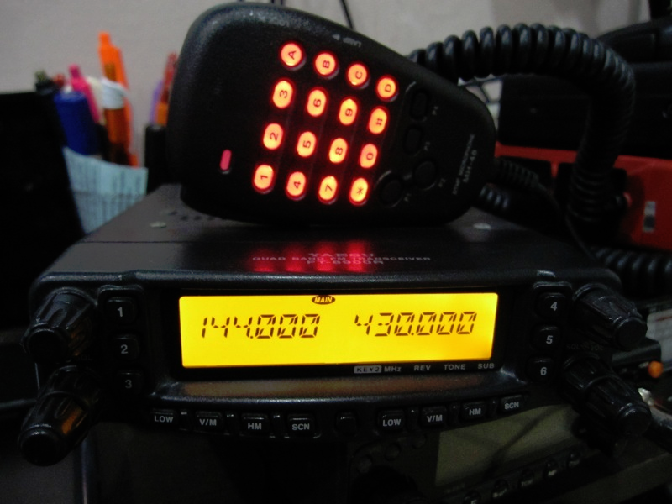
What is Amateur Radio?
A technical hobby
A volunteer public service
A way to meet new people
A way to keep in touch
A competitive activity

Slide 4
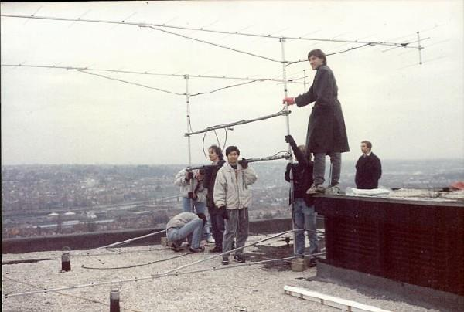
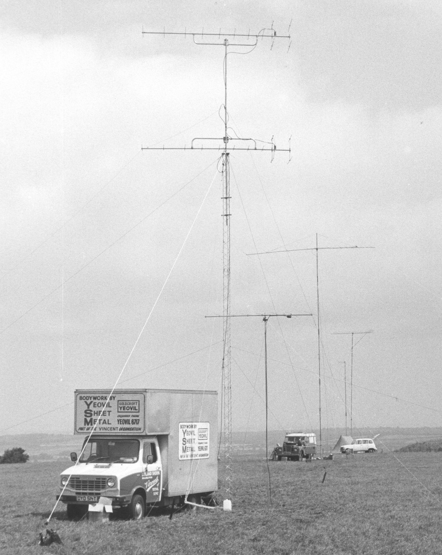
G3KMI History
Club callsign is G3KMI
Originally issued in 1953
Contesting
Trips to the Channel Islands
In use until 2001, re-issued in 2011

Slide 5
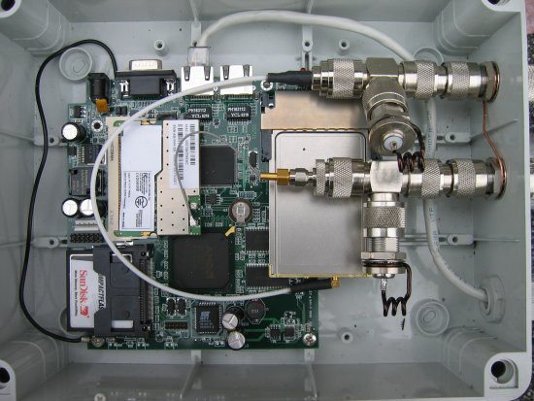
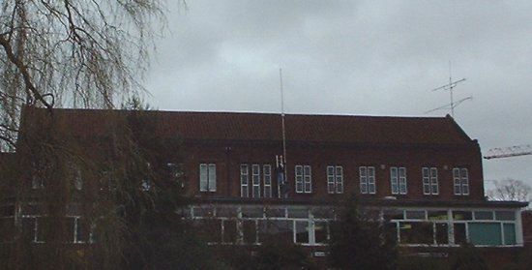
SOWN History
Formed in early 2000s
Provided the first wireless network on campus
Provided a fast mesh network for students before broadband was affordable

Slide 6
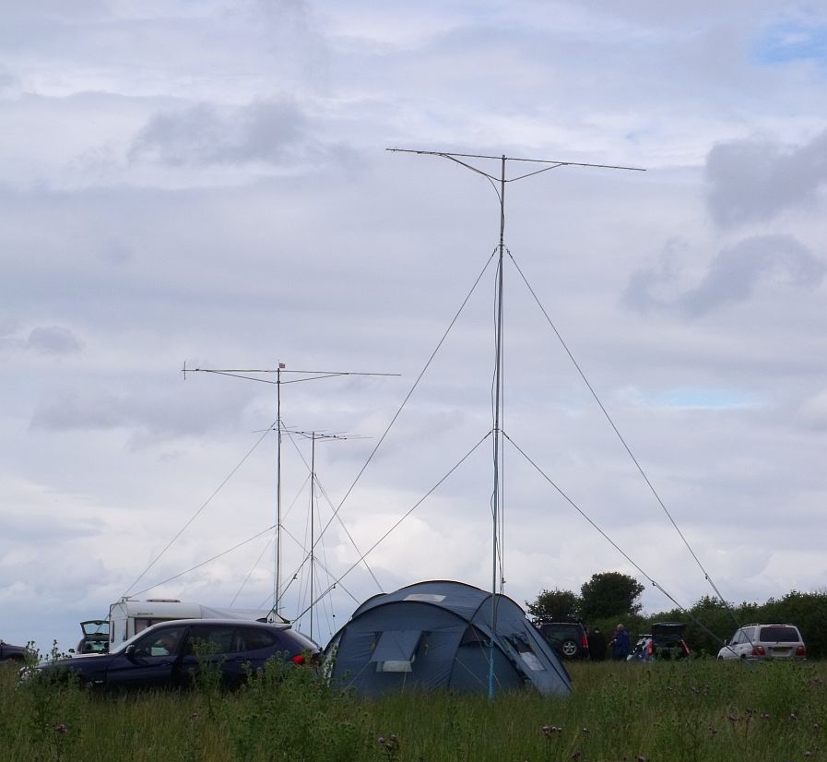
The Present
COVID prevented in-person activity causing society to shrink.
We are ready to rebuild!
Regular meetings
Outings, training, talks, and workshops
Growing number of licensed members
SOWN[at]Home
Notes:
6

Slide 7
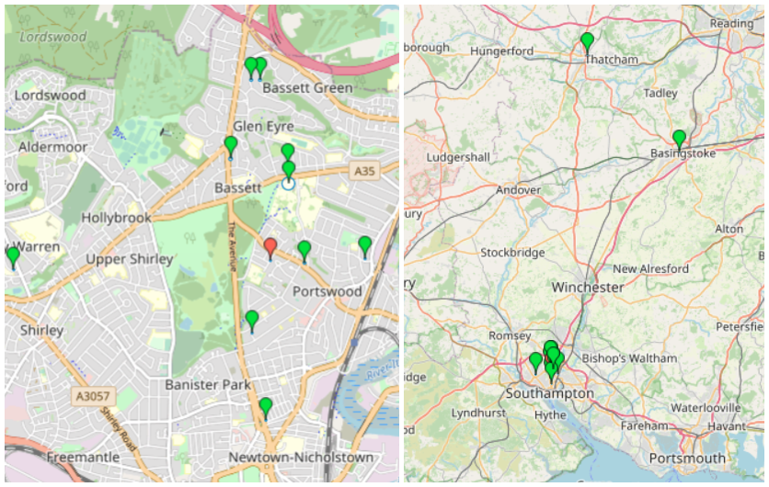
Location of the Current SOWN nodes

Slide 8
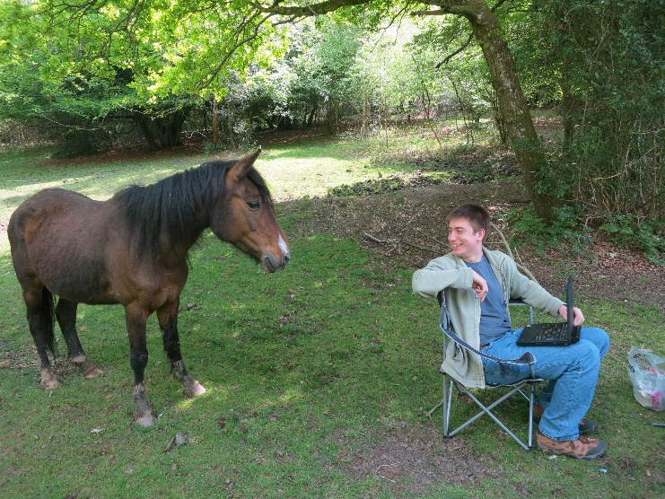
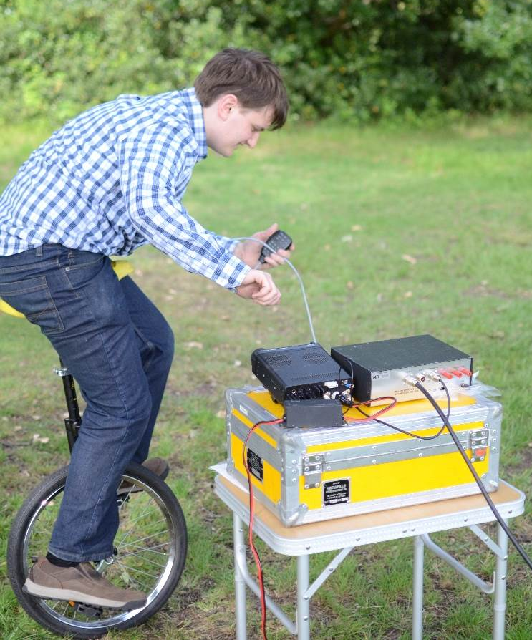
What’s on Offer
Training
Help with exams
Advice
Equipment setup help
Operating evenings
Society outings
Workshops
Guest speakers?
A friendly atmosphere

Slide 9
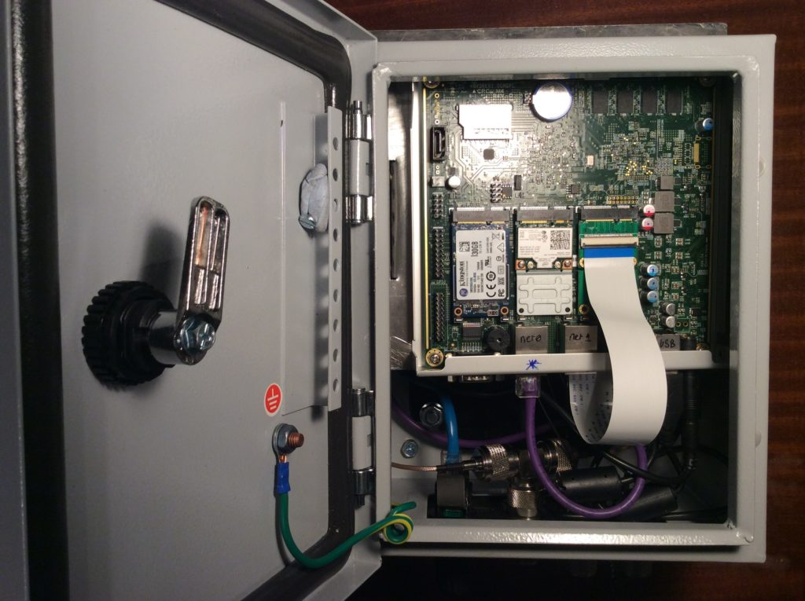
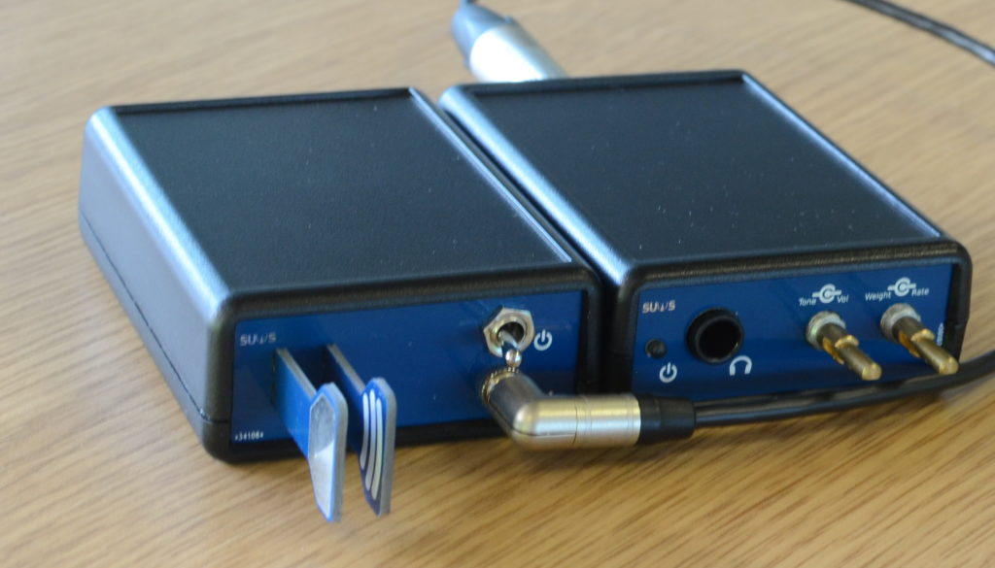
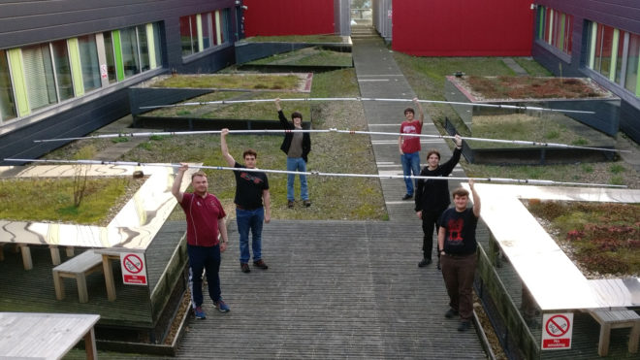
Projects
SOWN[at]anywhere (ongoing)
Modular Demo Kit (ongoing)
SUWS WebSDR (ongoing)
Raspberry Pi FM transmitter (paused)
HF Yagi Refurbishment (paused)
Morse sounder (complete)
Raspberry PiZero SSTV (complete)
Powerpole Distribution Box (complete)

Slide 10
Upcoming Events
All events can be seen on https://www.suws.org.uk/wiki/Events (iCal)
Introductory Outing (date based on consensus) – Probably a weekend.
Planned Talks (dates to be confirmed)
Getting your licence (Immediately following this)
SOWN
Notes:
10

Slide 11
Get Involved!
Get Licensed!
suws.org.uk
sown.org.uk
Join #G3KMI and #sown on irc.libera.chat
Get a SOWN[at]home node
Weekly meetings –
To be arranged, probably Thursdays at 18:00 via Teams, hopefully in person soon.
Operating outings & evenings

Slide 12
Questions?

